Slide 1
Mastering Pester PowerShell Unit and Infrastructure Testing
Jaap Brasser
Jaap_brasser / jaapbrasser
1 / 15

Slide 2
Keep this here and replace it with the update sponsor image that will be sent out the week prior to summit

Slide 3





Jaap Brasser
Justin Grote
Tweets
Codes
Works
Does
Likes
Tweets
Codes
Works
Does
Likes
JustinWGrote
justingrote
Yakshaver
Yakshaver
Spock
jaap_brasser
jaapbrasser
Developer Advocate
Coder, Speaker, Aspiring blogger
Cloud Automation, Scripting & Dev Tools

Slide 4
Agenda
Introduction to Testing in PowerShell
Getting Started with Pester
Advanced Pester Testing Techniques
Best Practices and Real-World Examples
Wrap-Up

Slide 5
Introduction to Testing in PowerShell

Slide 6
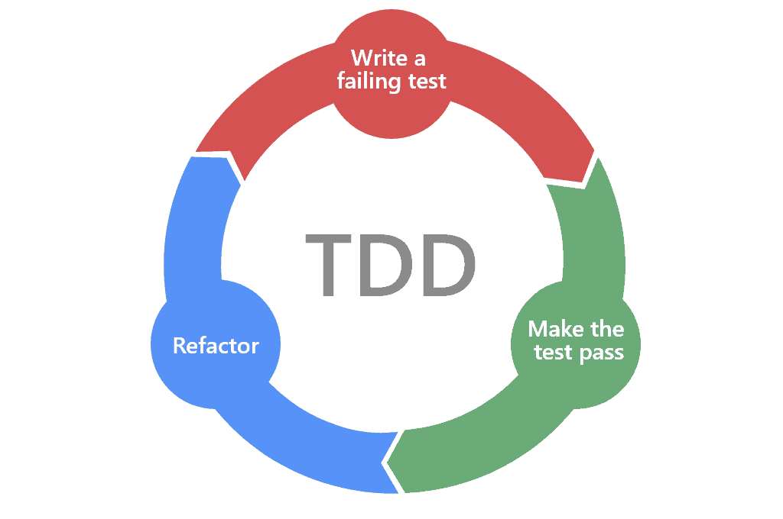
The Importance of Testing in Software Development
Ensure code reliability and maintainability.
Facilitate easier updates and feature additions.
Reduce bugs and issues in production.

Slide 7

Types of Tests
Unit Tests
Integration Tests
Acceptance
Infrastructure Tests
Performance Tests
Security Tests

Slide 8

What is Pester
Testing framework for PowerShell
In PowerShell
Domain Specific Language
Open Source
Integrates in VS Code

Slide 9
Benefits of using Pester
Integrated in PowerShell
Shipped with Windows
Ease of use
Justin is here to help you understand Pester

Slide 10

Pester 4, Pester 5
No more PowerShell v2
Multiple command deprecated
Scoping is more strictly enforced
Place your variables in before* it after*
Nothing in Context

Slide 11
Demos

Slide 12
Getting Started with Pester

Slide 13
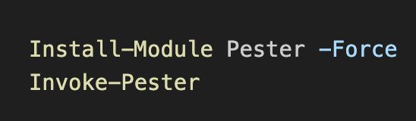
First Steps
Update Pester
Write Tests
Run Tests

Slide 14
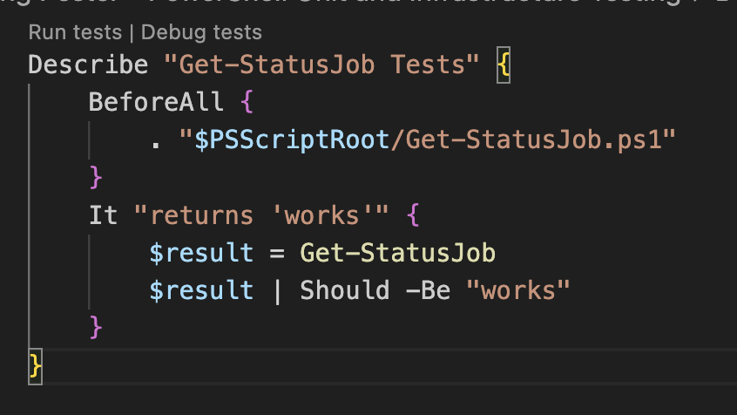
Writing a Pester Test
.tests.ps1
Import required modules / functions
Test functionality
Return results

Slide 15
Running Tests with Pester
Invoke-Pester
Specify which tests
Defaults to run all tests
Can be automated in CI pipelines
-Passthru
-CI

Slide 16
Demos

Slide 17
Advanced Pester Techniques

Slide 18
Mocking with Parameter Filters
Invoke-Pester
Specify which tests
Defaults to run all tests
Can be automated in CI pipelines
-Passthru
-CI

Slide 19
Testing with TestDrive
Temporary file system
Read / Write / Modify files
TestDrive per Test file
Different from v4 (Describe)
Blackhole for data
Deleted after run
env:/temp

Slide 20
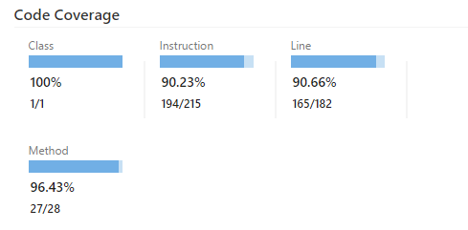
Code Coverage
Percentage of Code that is covered
Higher number is better

Slide 21
Demos

Slide 22
Best Practices and Real-World Examples

Slide 23
Demos

Slide 24
Wrap-up

Slide 25

Questions

Slide 26

THANK YOU
Please review this session

